Slide 1
Xamarin.Forms 4. predavanje
Ivan Čuljak

Slide 2
Consuming Web Services

Slide 3
SOAP
WCF
REST
Azure Mobile Apps (Services)
Amazon SimpleDB Services
Parse
...
Notes:
Xamarin.Forms has a complete cross platform animations api as well. It takes advantage of the underlying APIs on each platform such as CoreAnimation on iOS.
Additionally, it is completely asynchronous with an async/await api.

Slide 4
Consuming a RESTful Web Service

Slide 5
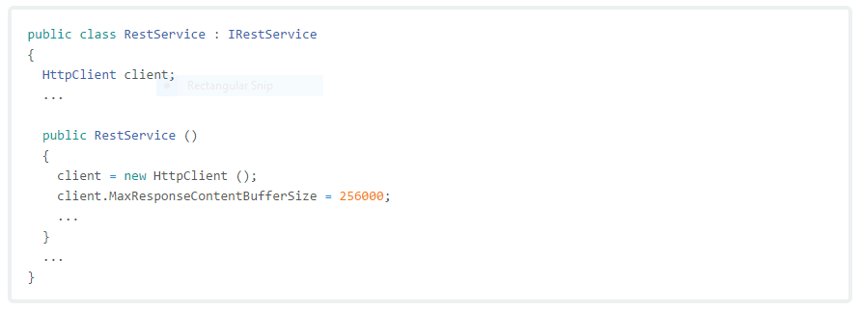
Creating the HTTPClient Object
Notes:
First we will create our own Xamarin.Forms control in our shared code. In this case we are simply inheriting from “Entry”, however you can even inherit from View which can be anything.
Optional: Add custom properties and bindings

Slide 6
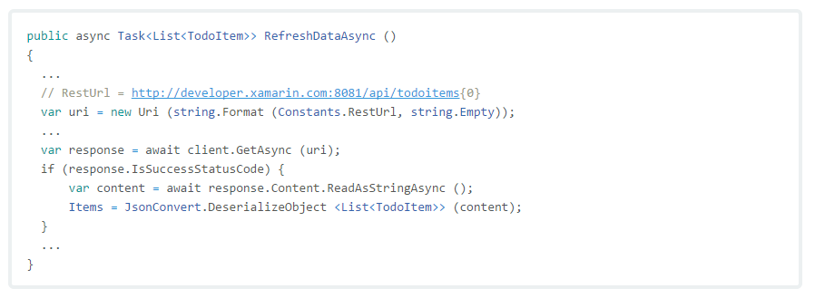
Retrieving Data
Notes:
First we will create our own Xamarin.Forms control in our shared code. In this case we are simply inheriting from “Entry”, however you can even inherit from View which can be anything.
Optional: Add custom properties and bindings

Slide 7
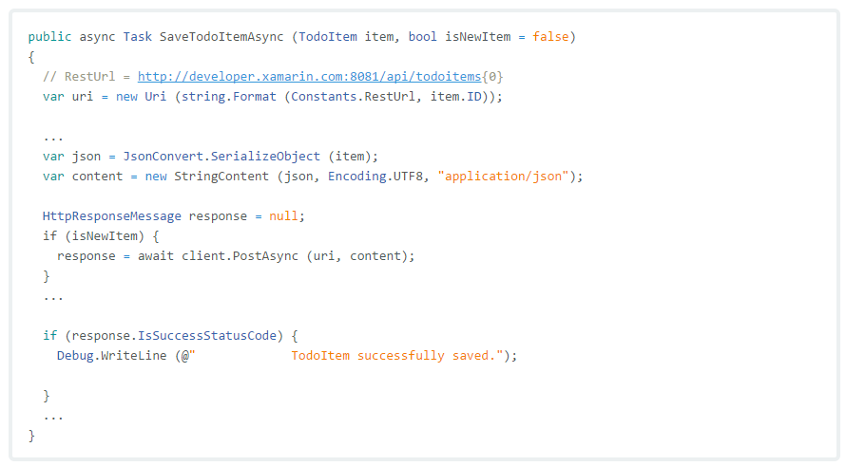
Creating Data

Slide 8
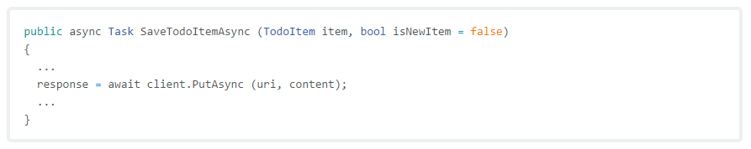
Updating Data

Slide 9
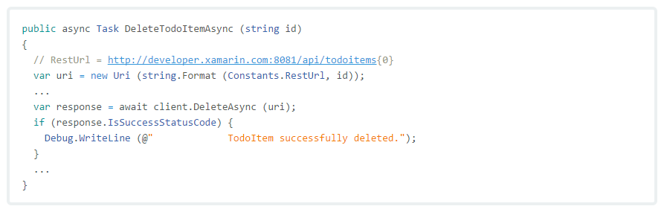
Deleting Data

Slide 10
Modern Http Client

Slide 11
One simple line of code

Slide 12
Consuming an Azure Mobile App (Service)

Slide 13
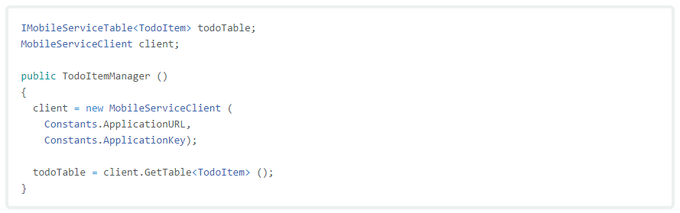
Consuming an Azure Mobile Services Instance

Slide 14
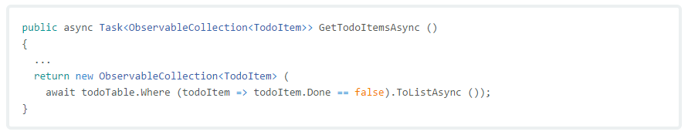
Querying Data

Slide 15
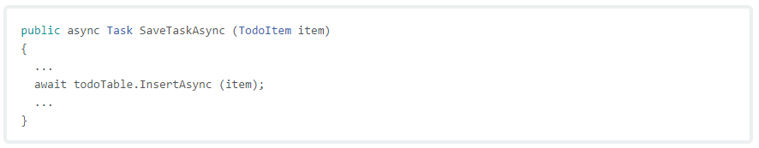
Inserting Data

Slide 16
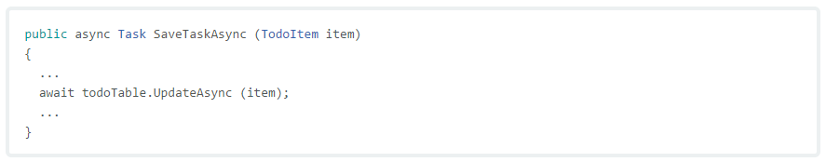
Updating Data

Slide 17
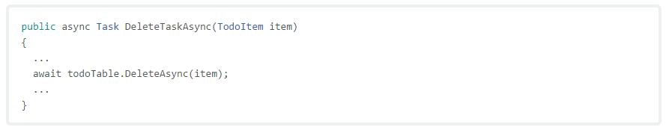
Deleting Data

Slide 18
Authenticating Access to Web Services

Slide 19
Authenticating a RESTful Web Service
Authenticating Users with an Identity Provider
Authenticating Users with Azure Mobile Services...
Notes:
Xamarin.Forms has a complete cross platform animations api as well. It takes advantage of the underlying APIs on each platform such as CoreAnimation on iOS.
Additionally, it is completely asynchronous with an async/await api.

Slide 20
Authenticating a RESTful Web Service

Slide 21


Workflow

Slide 22
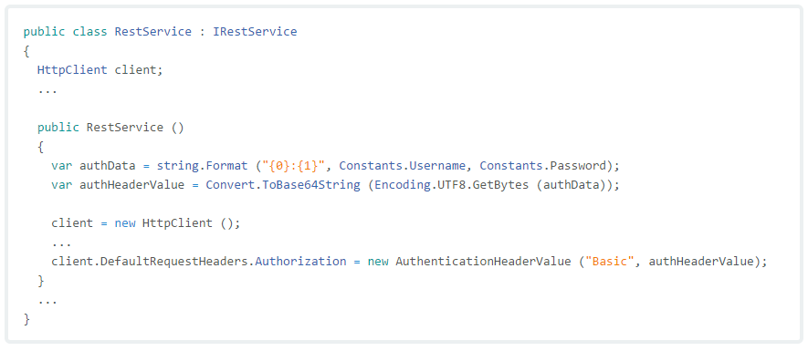
Code example

Slide 23
Authenticating Users with an Identity Provider

Slide 24
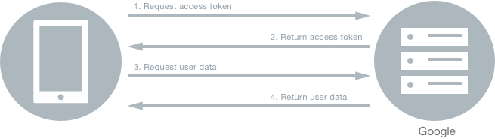
Using Xamarin.Auth to Authenticate Users

Slide 25
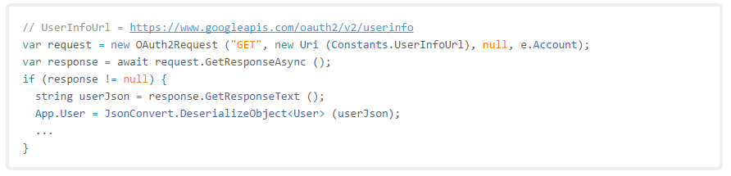
Making Requests for Data

Slide 26

Storing and Retrieving Account Information on Devices

Slide 27
Authenticating Users with Azure Mobile Apps (Services)

Slide 28
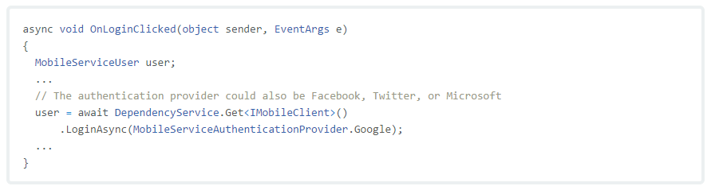
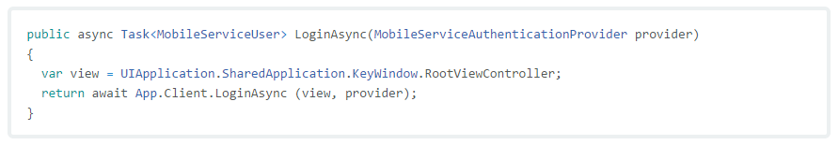
Logging in Users

Slide 29
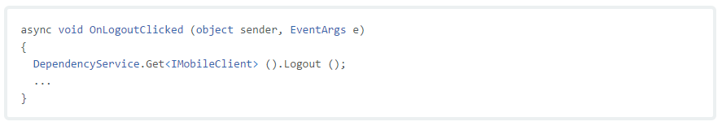
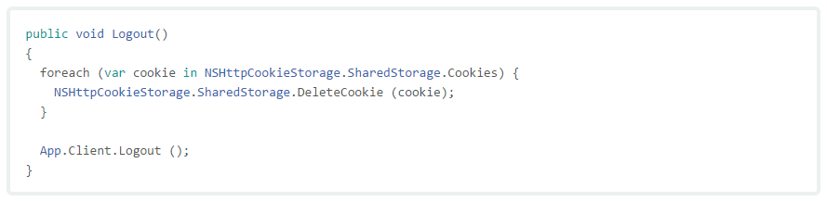
Logging Out Users

Slide 30
Data Caching

Slide 31

One of many workflows

Slide 32
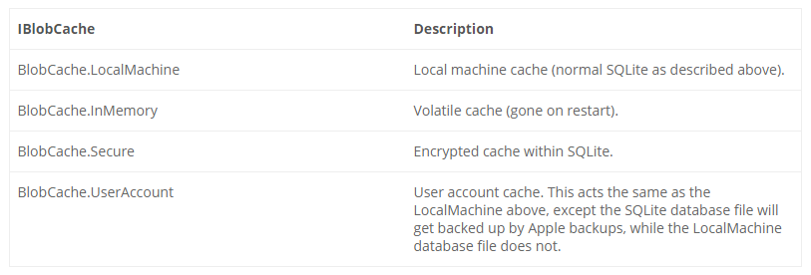
Akavache

Slide 33
Checking Connectivity

Slide 34


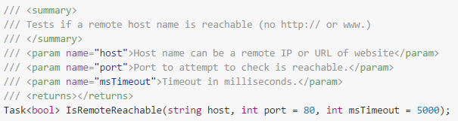

Connectivity Plugin

